Slide 1
COHESION & COUPLING IN OOP
Members
Ddiiro Joseph.
Alwoch Sophia.
Asamo Elizabeth.
Balenzi Philip.

Slide 2
Cohesion
In computer programming, cohesion refers to the degree to which the elements inside a module belong together. In one sense, it is a measure of the strength of relationship between the methods and data of a class and some unifying purpose or concept served by that class.
In another sense, it is a measure of the strength of relationship between the class's method and data themselves.
Cohesion focuses on how single module/class is designed. Higher the cohesiveness of the module/class, better is the OO design.
If our module performs one task and nothing else or has a clear purpose, our module has high cohesion. On the other hand, if our module tries to encapsulate more than one purpose or has an unclear purpose, our module has low cohesion.
Modules with high cohesion tend to be preferable, simple because high cohesion is associated with several desirable traits of software including robustness, reliability, and understandability.
Low cohesion is associated with undesirable traits such as being difficult to maintain, test, reuse, or even understand.
Cohesion is often contrasted with coupling. High cohesion often correlates with loose coupling, and vice versa.

Slide 3
Types of Cohesion in details.
Coincidental cohesion is when parts of a module are grouped arbitrarily; the only relationship between the parts is that they have been grouped together. For example: Utilities class.
Logical cohesion is when parts of a module are grouped because they are logically categorized to do the same thing even though they are different by nature. For example: grouping all mouse and keyboard input handling routines.
Temporal cohesion is when parts of a module are grouped by when they are processed - the parts at a particular time in program execution. For example: A function which is called after catching an exception which closes open files, creates an error log, and notifies the user.
Procedural cohesion is when parts of a module are grouped because they always follow a certain sequence of execution. For example: a function which checks file permissions and then opens the file.

Slide 4
Communicational cohesion is when parts of a module are grouped because they operate on the same data.There are cases where communicational cohesion is the highest level of cohesion that can be attained under the circumstances.For example: a module which operates on the same record of information.
Sequential cohesion is when parts of a module are grouped because the output from one part is the input to another part like an assembly line.For example: a function which reads data from a file and processes the data.
Functional cohesion is when parts of a module are grouped because they all contribute to a single well-defined task of the module.

Slide 5
Coupling
Coupling is the degree of interdependence between software modules; a measure of how closely connected two routines or modules are; the strength of the relationships between modules.
It is important to note that under coupling, we can categorise a class as either to have either low or high coupling.
Low coupling refers to a relationship in which one module interacts with another module through a simple and stable interface and does not need to be concerned with the other module’s internal implementation
Tight coupling means when a group of classes are highly dependent on one another. This scenario arises when a class assumes too many responsibilities, or when one concern is spread over many classes rather than having its own class.

Slide 6
Types of Coupling in OOP
Subclass coupling Describes the relationship between a child and its parent. The child is connected to its parent, but the parent is not connected to the child.
Temporal coupling When two actions are bundled together into one module just because they happen to occur at the same time.
Dynamic coupling The goal of this type of coupling is to provide a run-time evaluation of a software system. It has been argued that static coupling metrics lose precision when dealing with an intensive use of dynamic binding or inheritance. In the attempt to solve this issue, dynamic coupling measures have been taken into account.

Slide 7
Semantic coupling This kind of coupling considers the conceptual similarities between software entities using, for example, comments and identifiers and relying on techniques.
Logical coupling Logical coupling exploits the release history of a software system to find change patterns among modules or classes.

Slide 8
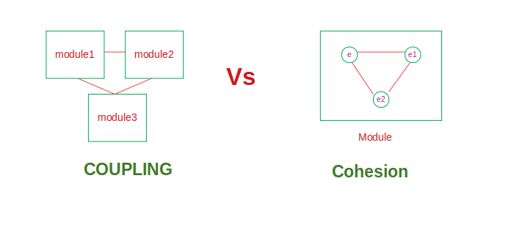
Diagrammatic representation of the difference between coupling and cohesion.

